Slide 1
Computer Architecture Concepts
Part 16 – Using MIPS instructions and registers in MARS simulator

Slide 2
Objectives
Start to look at the MARS MIPS Assembler and Runtime Simulator
Download from
https://courses.missouristate.edu/KenVollmar/mars/download.htm
Using registers in MIPS Assembly language
Using the add instruction

Slide 3
Assembly language and Assemblers
Machine code is binary and difficult for humans to read or write
Assembly languages
Use mnemonics (short written forms of instruction)
Use human readable labels to identify memory locations
Needs to be assembled to convert to machine code
An Assembler translates an Assembly language instruction into the equivalent binary machine code
add $t0, $s1, $s2
Assembly Code
00000010001100100100000000100000₂
Machine Code

Slide 4
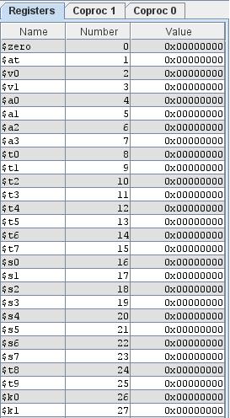
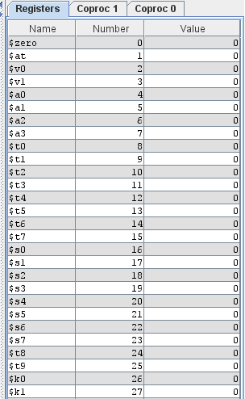
MIPS registers
MIPS has 32 registers each holding 32 bits
MARS allows us to see the contents of the registers in hex or decimal

Slide 5
MIPS Register Usage
Name | Register number | Usage
$zero | 0 | the constant value 0
$at | 1 | assembler temporary (for assembler use)
$v0-$v1 | 2-3 | values returned by procedures/functions
$a0-$a3 | 4-7 | arguments provided to procedures/functions
$t0-$t7 | 8-15 | temporaries (for scratch work)
$s0-$s7 | 16-23 | saved registers (saved across procedure calls)
$t8-$t9 | 24-25 | more temporaries
$gp | 28 | global pointer (tracks start of process's space)
$sp | 29 | stack pointer (tracks top of stack)
$fp | 30 | frame pointer (tracks start of procedure's space)
$ra | 31 | return address (where to return from procedure)
In programs we use the register names, e.g. $zero, $a0, $s1

Slide 6
Arithmetic Operations
To add the values in two registers
Example:
Add together the values in $t1 and $t2
Store the result in $s1
The contents of $t1 and $t2 will be unchanged
With the same register as a source and destination
Update the value of $s5 by adding the value in $t1 to what was already in $s5
This format is fixed
A mnemonic, a destination and two sources
add $s1, $t1, $t2
add $s5, $s5, $t1

Slide 7
Immediate Operands
When we want to specify a fixed amount to add
Constant data specified in an instruction
The constant (immediate value) must be the last operand
Example: work out the value of $t1 plus decimal 8 and store in $s1
Register $t1 is unchanged
No subtract immediate instruction
Just use a negative constant with add
addi $s1, $t1, 8
addi $s1, $t1, -2

Slide 8
The Constant Zero
MIPS register 0 ($zero) is the constant 0
Cannot be overwritten
Useful for common operations
Copy a value from one register to another
add $t2, $s1, $zero
This adds 0 to $s1 and stores the result in $t2
This will leave $t2 and Ss1 containing the same value as each other
Store an initial value in a register
addi $t3, $zero, 78
This adds 0 to decimal 78 and stores the result in $t3

Slide 9
Putting them together into a program
# Store decimal values 42 and 9 in registers $t1 and $t2 respectively
addi $t1, $zero, 42
addi $t2, $zero, 9
# Add them together and store the result in $s1
add $s1, $t1, $t2
# Add 10 to the result and store back in $s1
addi $s1, $s1, 10

Slide 10
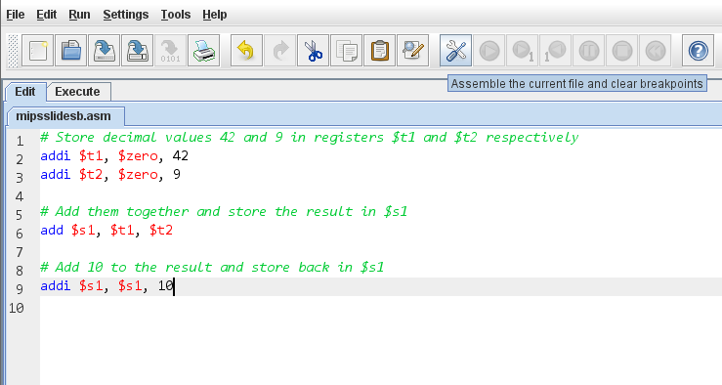
Putting the program into the MARS simulator
Comments start with a #
We need to save and assemble the program

Slide 11
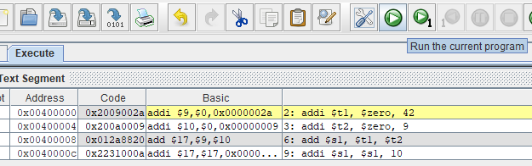
After assembling
The addresses for the program go up in 4s because MIPS is byte addressed but each instruction is 32 bits
The addresses and code are shown in hex (indicated by 0x)
In the code we can see 2a for the immediate value 42

Slide 12
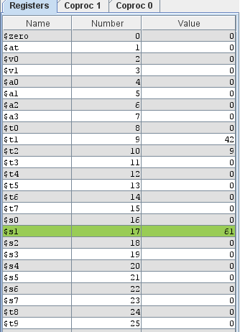
Running the program
We can run the whole program
We could run one step at a time
We see the values in the registers change

Slide 13
Summary
MIPS Assembly language
Specifying registers with a $
Writing a simple program to use registers and add numbers
MARS environment
Viewing contents of registers
Coding, assembling and running a program

